Slide 1
Lab 1 To implement various Diode clipper circuits and verify its performance using Multi-Sim simulator

Slide 2
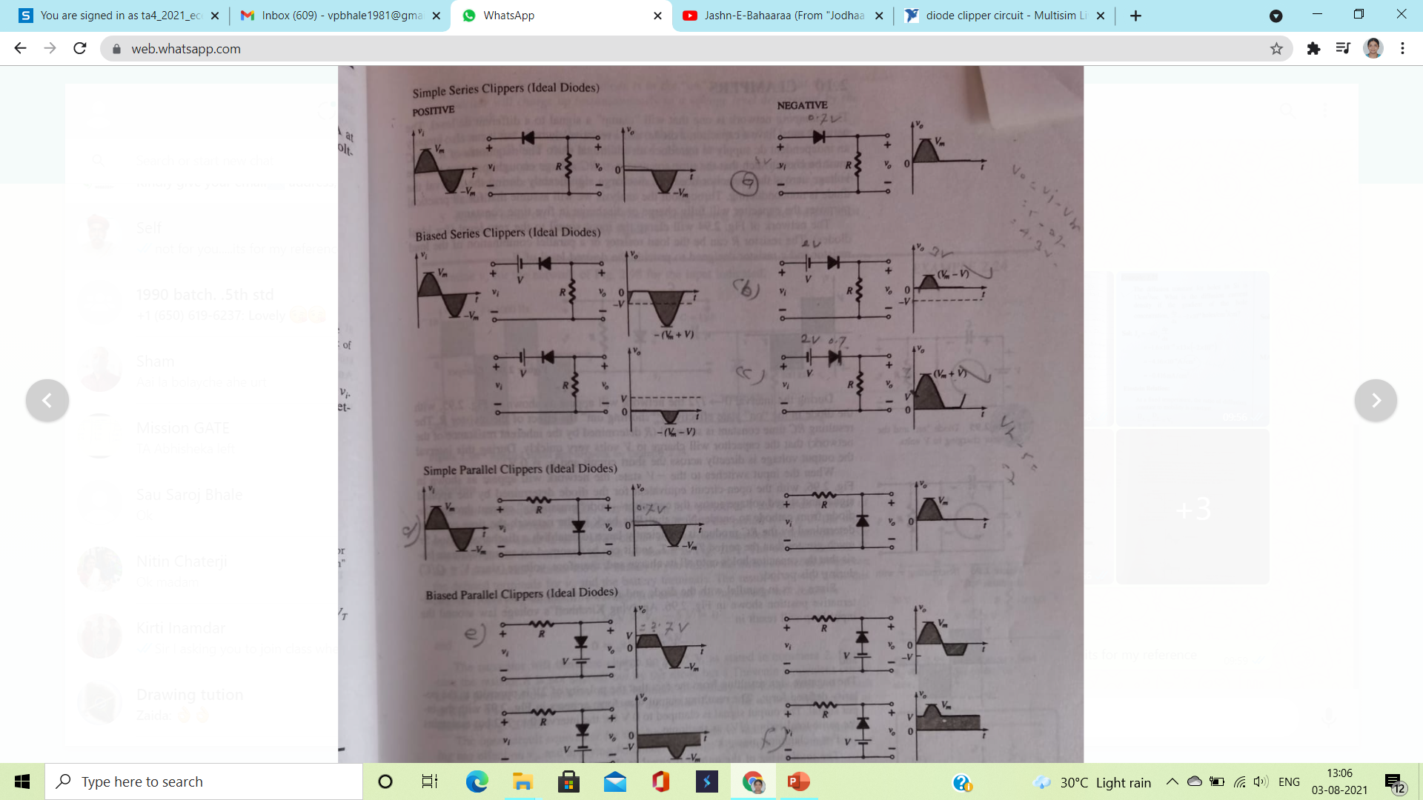
Assume diode as ideal for all circuit implementation:
(1) Vi input sinusoidal of 2Vpp and 1KHz frequency
V=1 V
Choose 1N4001 Diode
Resistance R= 1 K

Slide 3
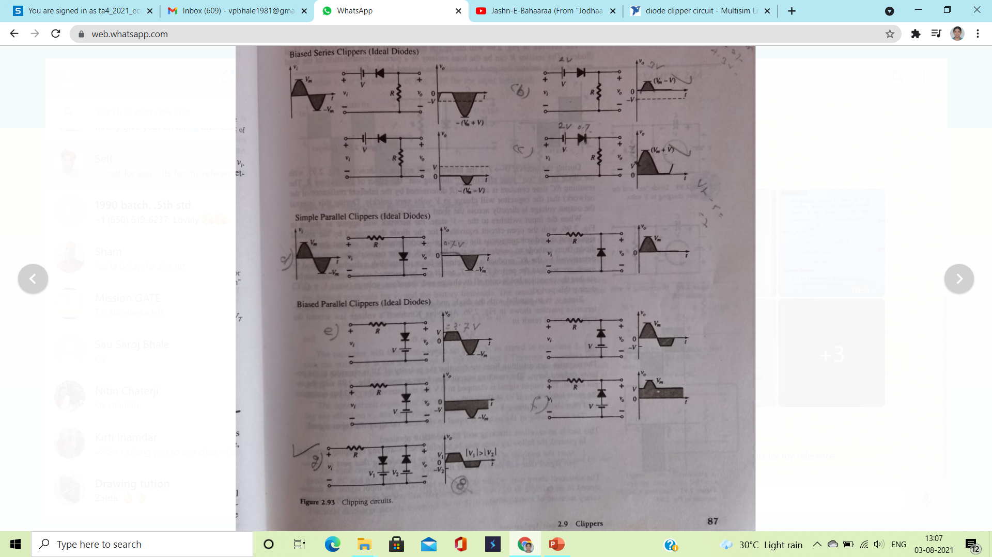
Biased series clippers

Slide 4
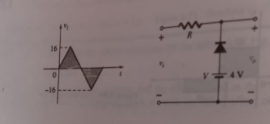
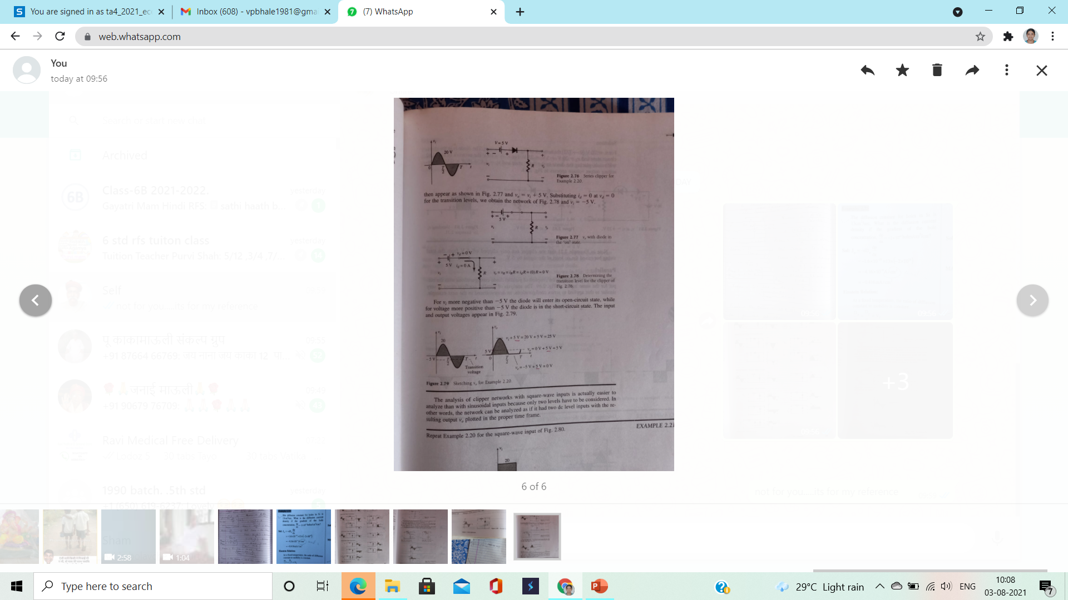
Assignment 1:

